Slide 1


AN INTRODUCTION TO BONDING
KNOCKHARDY PUBLISHING

Slide 2
BONDING
CONTENTS
Introduction
Chemical and physical bonding
Ionic bonding
Covalent bonding
Simple molecules
Van der Waals’ forces
Electronegativity & dipole-dipole interaction
Hydrogen bonding
Co-ordinate (dative covalent) bonding
Molecular solids
Covalent networks
Metallic bonding

Slide 3
STRUCTURE AND BONDING
The physical properties of a substance depend on its structure and type of bonding present. Bonding determines the type of structure.
Basic theory
noble gases (He, Ne, Ar, Kr, Xe and Rn) are all relatively, or totally, inert
this is due to their electronic structure which appears to confer stability
atoms without the electronic structure of a noble gas try to gain one
various ways are available according to an element’s position in the periodic table

Slide 4
STRUCTURE AND BONDING
The physical properties of a substance depend on its structure and type of bonding present. Bonding determines the type of structure.
TYPES OF BOND
CHEMICAL ionic (or electrovalent)
strong bonds covalent
dative covalent (or co-ordinate)
metallic
PHYSICAL van der Waals‘ forces - weakest
weak bonds dipole-dipole interaction
hydrogen bonds - strongest

Slide 5
IONIC
BONDING

Slide 6
THE IONIC BOND
Ionic bonds tend to be formed between elements whose atoms need to “lose” electrons to gain the nearest noble gas electronic configuration (n.g.e.c.) and those which need to gain electrons. The electrons are transferred from one atom to the other.

Slide 7
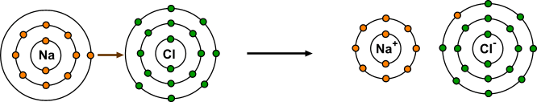
THE IONIC BOND
Ionic bonds tend to be formed between elements whose atoms need to “lose” electrons to gain the nearest noble gas electronic configuration (n.g.e.c.) and those which need to gain electrons. The electrons are transferred from one atom to the other.
Sodium Chloride

Slide 8
THE IONIC BOND
Ionic bonds tend to be formed between elements whose atoms need to “lose” electrons to gain the nearest noble gas electronic configuration (n.g.e.c.) and those which need to gain electrons. The electrons are transferred from one atom to the other.
Sodium Chloride
Na ——> Na+ + e¯ and Cl + e¯ ——> Cl¯
1s² 2s² 2p⁶ 3s¹ 1s² 2s² 2p⁶ 1s² 2s² 2p⁶ 3s² 3p⁵ 1s² 2s² 2p⁶ 3s² 3p⁶
or 2,8,1 2,8 2,8,7 2,8,8
An electron is transferred from the 3s orbital of sodium to the 3p orbital of chlorine both species end up with the electronic configuration of the nearest noble gas the resulting ions are held together in a crystal lattice by electrostatic attraction

Slide 9
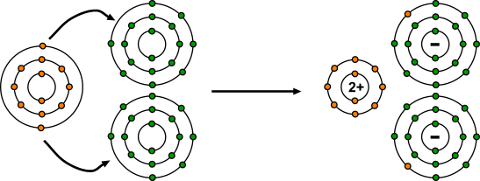
THE IONIC BOND
FORMATION OF MAGNESIUM CHLORIDE
e¯
Cl
Mg
ELECTRON
TRANSFER
Cl
e¯
Mg ——> Mg²⁺ + 2e¯ and 2Cl + 2e¯ ——> 2 Cl¯

Slide 10
THE FORMATION OF IONS
Positive ions
also known as cations; they are smaller than the original atom.
formed when electrons are removed from atoms.
the energy associated with the process is known as the ionisation energy (I.E.).
1st IONISATION ENERGY
The energy required to remove one mole of electrons (to infinity) from the one mole of gaseous atoms to form one mole of gaseous positive ions.
e.g. Na(g) ——> Na⁺(g) + e¯ or Mg(g) ——> Mg⁺(g) + e¯
Other points
Successive ionisation energies get larger as the proton:electron ratio increases.
large jumps in value occur when electrons are removed from shells nearer the nucleus because there is less shielding and more energy is required to overcome the attraction. if the I.E. values are very high, covalent bonding will be favoured (e.g. beryllium).

Slide 11
THE FORMATION OF IONS
Negative ions
known as anions
are larger than the original atom due to electron repulsion in outer shell
formed when electrons are added to atoms
energy is released as the nucleus pulls in an electron
this energy is the electron affinity.

Slide 12
IONIC BONDING
Animations

Slide 13
SODIUM CHLORIDE
Na
Cl
SODIUM ATOM
2,8,1
CHLORINE ATOM
2,8,7

Slide 14
SODIUM CHLORIDE
+
Na
Cl
SODIUM ION
2,8
CHLORIDE ION
2,8,8
both species now have ‘full’ outer shells; ie they have the electronic configuration of a noble gas

Slide 15
SODIUM CHLORIDE
+
Na
Cl
SODIUM ION
2,8
CHLORIDE ION
2,8,8
Na Na⁺ + e¯
2,8,1 2,8
ELECTRON TRANSFERRED
Cl + e¯ Cl¯
2,8,7 2,8,8

Slide 16
MAGNESIUM CHLORIDE
Cl
Mg
CHLORINE ATOMS
2,8,7
MAGNESIUM ATOM
2,8,2
Cl

Slide 17
MAGNESIUM CHLORIDE
Cl
2+
Mg
CHLORIDE IONS
2,8,8
MAGNESIUM ION
2,8
Cl

Slide 18
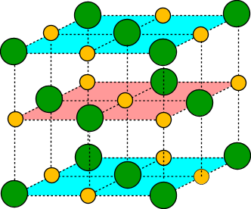
GIANT IONIC CRYSTAL LATTICE
Oppositely charged ions held in a regular
3-dimensional lattice by electrostatic attraction
The arrangement of ions in a crystal lattice depends on the relative sizes of the ions
Cl⁻
Chloride ion
Na⁺
Sodium ion
The Na⁺ ion is small enough relative to a Cl¯ ion to fit in the spaces so that both ions occur in every plane.

Slide 19
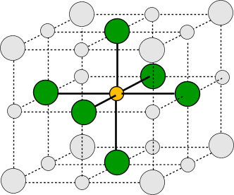
GIANT IONIC CRYSTAL LATTICE
Oppositely charged ions held in a regular
3-dimensional lattice by electrostatic attraction
The arrangement of ions in a crystal lattice depends on the relative sizes of the ions
Each Na⁺ is surrounded by 6 Cl¯ (co-ordination number = 6)
and each Cl¯ is surrounded by 6 Na⁺ (co-ordination number = 6).

Slide 20
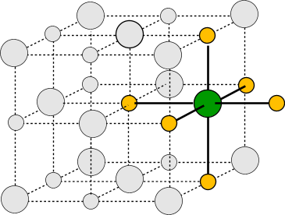
GIANT IONIC CRYSTAL LATTICE
Oppositely charged ions held in a regular
3-dimensional lattice by electrostatic attraction
The arrangement of ions in a crystal lattice depends on the relative sizes of the ions
Each Na⁺ is surrounded by 6 Cl¯ (co-ordination number = 6)
and each Cl¯ is surrounded by 6 Na⁺ (co-ordination number = 6).

Slide 21
Physical properties of ionic compounds
Melting point
very high A large amount of energy must be put in to overcome the
strong electrostatic attractions and separate the ions.
Strength
Very brittle Any dislocation leads to the layers moving and similarly charged
ions being next to each other. The repulsion splits the crystal.
Electrical do not conduct when solid - ions are held strongly in the lattice.
conduct when molten or in aqueous solution - the ions become
mobile and conduction takes place.
Solubility Insoluble in non-polar solvents but soluble in water
Water as it is a polar solvent and stabilises the separated ions.
Much energy is needed to overcome the electrostatic attraction and separate the ions.
Stability attained by being surrounded by polar water molecules compensates for this.

Slide 22
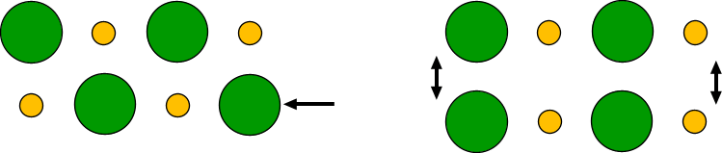
IONIC BONDING
BRITTLE IONIC LATTICES
-
-
-
+
-
+
+
+
+
+
+
-
+
-
-
+
-
+
+
+
IF YOU MOVE A LAYER OF IONS, YOU GET IONS OF THE SAME CHARGE NEXT TO EACH OTHER. THE LAYERS REPEL EACH OTHER AND THE CRYSTAL BREAKS UP.

Slide 23
IONIC COMPOUNDS - ELECTRICAL PROPERTIES
SOLID IONIC COMPOUNDS DO NOT CONDUCT ELECTRICITY
Cl⁻
Na⁺
Cl⁻
Na⁺
IONS ARE HELD STRONGLY TOGETHER
+ IONS CAN’T MOVE TO THE CATHODE
- IONS CAN’T MOVE TO THE ANODE
Na⁺
Cl⁻
Na⁺
Cl⁻
Cl⁻
Na⁺
Cl⁻
Na⁺
MOLTEN IONIC COMPOUNDS DO CONDUCT ELECTRICITY
Cl⁻
IONS HAVE MORE FREEDOM IN A LIQUID SO CAN MOVE TO THE ELECTRODES
Na⁺
Cl⁻
Na⁺
SOLUTIONS OF IONIC COMPOUNDS IN WATER
DO CONDUCT ELECTRICITY
Cl⁻
Na⁺
DISSOLVING AN IONIC COMPOUND IN WATER BREAKS UP THE STRUCTURE SO IONS ARE FREE TO MOVE TO THE ELECTRODES
Na⁺
Cl⁻

Slide 24
Questions to attempt
Review exercise 3.1 p53
Review exercise 3.2 p54
Review exercise 3.3 p56 & 57

Slide 25
Names and formulae of ionic compounds
Chapter 3.4 Chemistry for WA p57 – 61
Read and do Review exercise 3.4 p62 & 63
Chapter 3.5 Chemistry for WA p63 – 65
Read and do Review exercise 3.5 p66

Slide 26
Electron dot diagrams of ionic compounds
Chapter 3.6 Chemistry for WA p66 – 68
Read and do Review exercise 3.6 p68

Slide 27
Uses of ionic compounds
Chapter 3.7 Chemistry for WA p69
Read and do Review exercise 3.7 p70

Slide 28
Sodium chloride
Chapter 3.8 Chemistry for WA p70
Read and do Review exercise 3.8 p71

Slide 29
Calcium carbonate
Chapter 3.9 Chemistry for WA p72
Read and do Review exercise 3.9 p73

Slide 30
Questions to attempt
End of Chapter 3 Questions p74-77

Slide 31
COVALENT
BONDING

Slide 32
COVALENT BONDING
Definition consists of a shared pair of electrons with one electron being
supplied by each atom either side of the bond.
compare this with with dative covalent bonding
atoms are held together
because their nuclei which
have an overall positive charge
are attracted to the shared electrons
Formation between atoms of the same element; N₂, O₂, diamond, graphite
between atoms of different elements CO₂, SO₂
on the RHS of the table;
when one of the elements is in the CCl₄, SiCl₄
middle of the table;
with head-of-the-group elements BeCl₂
with high ionisation energies;
+
+

Slide 33
COVALENT BONDING
• atoms share electrons to get the nearest noble gas electronic configuration
• some don’t achieve an “octet” as they haven’t got enough electrons Al in AlCl₃
• others share only some - if they share all they will exceed their “octet” NH₃ and H₂O
• atoms of elements in the 3rd period onwards can exceed their “octet” if they wish a
they are not restricted to eight electrons in their “outer shell”

Slide 34

SIMPLE MOLECULES
Orbital theory
Covalent bonds are formed when orbitals, each containing one electron, overlap. This forms a region in space where an electron pair can be found; new molecular orbitals are formed.
orbital containing 1 electron
orbital containing 1 electron
overlap of orbitals provides a region in space which can contain a pair of electrons
The greater the overlap the stronger the bond.

Slide 35
HYDROGEN
H
H
Hydrogen atom needs one electron to complete its outer shell
atoms share a pair of electrons to form a single covalent bond
A hydrogen MOLECULE is formed
Another hydrogen atom also needs one electron to complete its outer shell
WAYS TO REPRESENT THE MOLECULE
H H
H H

Slide 36
HYDROGEN CHLORIDE
Cl
H
atoms share a pair of electrons to form a single covalent bond
Chlorine atom needs one electron to complete its outer shell
Hydrogen atom also needs one electron to complete its outer shell
WAYS TO REPRESENT THE MOLECULE
H Cl
H Cl

Slide 37
METHANE
WAYS TO REPRESENT
THE MOLECULE
H
Each hydrogen atom needs 1 electron to complete its outer shell
H
H
C
H C H
H
H
H
H
A carbon atom needs 4 electrons to complete its outer shell
Carbon shares all 4 of its electrons to form 4 single covalent bonds
H C H
H

Slide 38
AMMONIA
WAYS TO REPRESENT
THE MOLECULE
H
N
Each hydrogen atom needs one electron to complete its outer shell
H N H
H
H
H
H N H
Nitrogen can only share 3 of its 5 electrons otherwise it will exceed the maximum of 8
A LONE PAIR REMAINS
Nitrogen atom needs 3 electrons to complete its outer shell
H

Slide 39
WATER
WAYS TO REPRESENT
THE MOLECULE
Each hydrogen atom needs one electron to complete its outer shell
H
O
H O
H
H
Oxygen atom needs 2 electrons to complete its outer shell
Oxygen can only share 2 of its 6 electrons otherwise it will exceed the maximum of 8
2 LONE PAIRS REMAIN
H O
H

Slide 40
HYDROGEN
H
H
H
H
both atoms need one electron to complete their outer shell
atoms share a pair of electrons to form a single covalent bond
DOT AND CROSS DIAGRAM
H H
H H

Slide 41
HYDROGEN CHLORIDE
Cl
H
Cl
H
atom needs one electron to complete its outer shell
atom also needs one electron to complete its outer shell
atoms share a pair of electrons to form a single covalent bond
H Cl
H Cl

Slide 42
METHANE
H
H
H
H
C
H
C
H
H
H
atom needs four electrons to complete its outer shell
each atom needs one electron to complete its outer shell
Carbon shares all 4 of its electrons to form 4 single covalent bonds
H
H
DOT AND CROSS DIAGRAM
H C H
H C H
H
H

Slide 43
AMMONIA
H
H
H
N
H
N
H
H
atom needs three electrons to complete its outer shell
each atom needs one electron to complete its outer shell
Nitrogen can only share 3 of its 5 electrons otherwise it will exceed the maximum of 8
A LONE PAIR REMAINS
H N H
H N H
H
H

Slide 44
WATER
H
H
O
O
H
H
atom needs two electrons to complete its outer shell
each atom needs one electron to complete its outer shell
Oxygen can only share 2 of its 6 electrons otherwise it will exceed the maximum of 8
TWO LONE PAIRS REMAIN
H O
H O
H
H

Slide 45
OXYGEN
O
O
O
O
each atom needs two electrons to complete its outer shell
each oxygen shares 2 of its electrons to form a
DOUBLE COVALENT BOND
O O

Slide 46
Some questions to attempt
Review exercise 4.1 p83
Review exercise 4.2 p85

Slide 47
SIMPLE COVALENT MOLECULES
Bonding Atoms are joined together within the molecule by covalent bonds.
Electrical Don’t conduct electricity as they have no mobile ions or electrons
Solubility Tend to be more soluble in organic solvents than in water;
some are hydrolysed
Boiling point Low - intermolecular forces (van der Waals’ forces) are weak;
they increase as molecules get a larger surface area
e.g. CH₄ -161°C C₂H₆ - 88°C C₃H₈ -42°C
as the intermolecular forces are weak, little energy is required to
to separate molecules from each other so boiling points are low
some boiling points are higher than expected for a given mass
because you can get additional forces of attraction

Slide 48
Some questions to attempt
Review exercise 4.3 p88

Slide 49
Shapes and polarity of covalent molecules
See separate Powerpoint Presentation “Shapes”

Slide 50
Determining the polarity of molecules
Where a molecule contains more than one polar bond, the polarity of the molecule is found by adding vectorially each of the individual bond polarities.
For a molecule to be polar the following conditions must apply:
The molecule must contain one or more polar bonds.
The molecule must not be completely symmetrical.

Slide 51
Polar Bonds
A bond formed between two atoms which differ greatly in electronegativity, such as Li and F, will be ionic because of the strong tendency for an electron to be transferred completely from the metallic element to the non-metallic element.
When a bond is formed between two identical atoms such as two Cl atoms in Cl₂ the electrons are shared equally and the bond is purely covalent.
When two different atoms form a covalent bond, the electron pair is not shared equally between the two atoms. The electron pair spends more time in the vicinity of the more electronegative atom. These bonds are called polar bonds. One atom acquires a small positive charge (+δ) and the other a small negative charge (-δ).
e.g. HCl

Slide 52
Draw an electron dot diagram for BeCl₂
Name of shape?
Polar or non-polar?

Slide 53
Draw an electron dot diagram for BF₃
Name of shape?
Polar or non-polar?

Slide 54
Draw an electron dot diagram for CF₄
Name of shape?
Polar or non-polar?

Slide 55
Draw an electron dot diagram for water
Name of shape?
Polar or non-polar?

Slide 56
Draw an electron dot diagram for ammonia
Name of shape?
Polar or non-polar?

Slide 57
Draw an electron dot diagram for CH₃Cl
Name of shape?
Polar or non-polar?

Slide 58
Draw an electron dot diagram for CO₂
Name of shape?
Polar or non-polar?

Slide 59
Draw an electron dot diagram for CCl₂F₂
Name of shape?
Polar or non-polar?

Slide 60
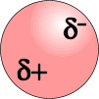
VAN DER WAALS’ FORCES
INSTANTANEOUS DIPOLE-INDUCED DIPOLE FORCES
Although the bonding within molecules is strong, that between molecules is weak. Molecules and monatomic noble gases are subject to weak attractive forces.
Instantaneous dipole-induced dipole forces
Because electrons move quickly in orbitals, their position is
constantly changing; at any given instant they could be anywhere
in an atom. The possibility will exist that one side will have more
electrons than the other. This will give rise to a dipole...

Slide 61
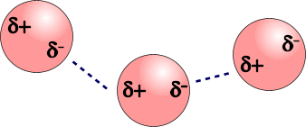
VAN DER WAALS’ FORCES
INSTANTANEOUS DIPOLE-INDUCED DIPOLE FORCES
Although the bonding within molecules is strong, that between molecules is weak. Molecules and monatomic noble gases are subject to weak attractive forces.
Instantaneous dipole-induced dipole forces
Because electrons move quickly in orbitals, their position is
constantly changing; at any given instant they could be anywhere
in an atom. The possibility will exist that one side will have more
electrons than the other. This will give rise to a dipole...
The dipole on one atom induces dipoles on nearby atoms
Atoms are now attracted to each other by a weak forces
The greater the number of electrons, the stronger the attraction
and the greater the energy needed to separate the particles.

Slide 62
VAN DER WAALS’ FORCES
INSTANTANEOUS DIPOLE-INDUCED DIPOLE FORCES
Although the bonding within molecules is strong, that between molecules is weak. Molecules and monatomic noble gases are subject to weak attractive forces.
Instantaneous dipole-induced dipole forces
Because electrons move quickly in orbitals, their position is
constantly changing; at any given instant they could be anywhere
in an atom. The possibility will exist that one side will have more
electrons than the other. This will give rise to a dipole...
The dipole on one atom induces dipoles on nearby atoms
Atoms are now attracted to each other by a weak forces
The greater the number of electrons, the stronger the attraction
and the greater the energy needed to separate the particles.
NOBLE GASES ALKANES
Electrons B pt. Electrons B pt.
He 2 -269°C CH₄ 10 -161°C
Ne 10 -246°C C₂H₆ 18 - 88°C
Ar 18 -186°C C₃H₈ 26 - 42°C
Kr 36 -152°C

Slide 63
ELECTRONEGATIVITY
“The ability of an atom to attract the pair of electrons in a covalent bond to itself.”
Non-polar bond similar atoms have the same electronegativity
they will both pull on the electrons to the same extent
the electrons will be equally shared
Polar bond different atoms have different electronegativities
one will pull the electron pair closer to its end
it will be slightly more negative than average, d-
the other atom will be slightly less negative, or more positive, d+
a dipole is formed and the bond is said to be polar
the greater the electronegativity difference, the greater the polarity
Pauling Scale a scale for measuring electronegativity

Slide 64
ELECTRONEGATIVITY
“The ability of an atom to attract the pair of electrons in a covalent bond to itself.”
Pauling Scale a scale for measuring electronegativity
values increase across periods
values decrease down groups
fluorine has the highest value
H
2.1
Li Be B C N O F
1.0 1.5 2.0 2.5 3.0 3.5 4.0
Na Mg Al Si P S Cl
0.9 1.2 1.5 1.8 2.1 2.5 3.0
K Br
0.8 2.8
INCREASE
INCREASE

Slide 65
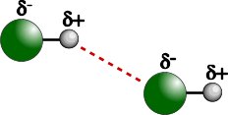
DIPOLE-DIPOLE INTERACTION
Occurrence occurs between molecules containing polar bonds
acts in addition to the basic van der Waals’ forces
the extra attraction between dipoles means that
more energy must be put in to separate molecules
get higher boiling points than expected for a given mass
Boiling points
of hydrides
Mr °C
CH₄ 16 -161
SiH₄ 32 -117
GeH₄ 77 -90
SnH₄ 123 -50
NH₃ 17 -33
PH₃ 34 -90
AsH₃ 78 -55
SbH₃ 125 -17
Mr °C
H₂O 18 +100
H₂S 34 -61
H₂Se 81 -40
H₂Te 130 -2
HF 20 +20
HCl 36.5 -85
HBr 81 -69
HI 128 -35

Slide 66
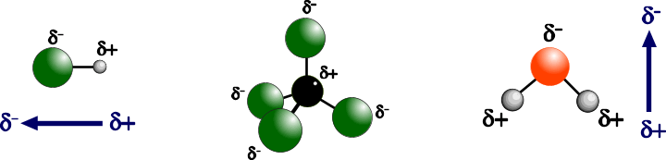
POLAR MOLECULES
Occurrence not all molecules containing polar bonds are polar overall
if bond dipoles ‘cancel each other out’ the molecule won’t be polar
if there is a ‘net dipole’ the molecule will be polar
HYDROGEN CHLORIDE TETRACHLOROMETHANE WATER
NET DIPOLE - POLAR NON-POLAR NET DIPOLE - POLAR

Slide 67
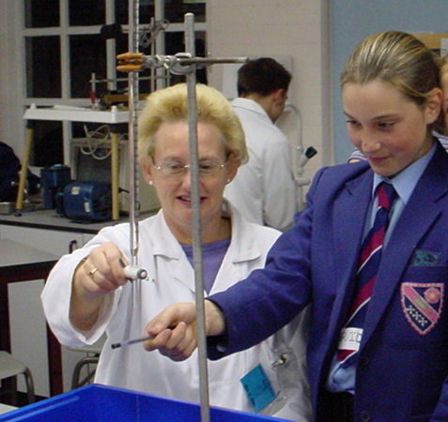
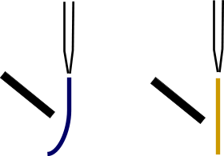
POLAR MOLECULES
Evidence place a liquid in a burette
allow it to run out
place a charged rod alongside the stream of liquid
polar molecules will be attracted by electrostatic attraction
non-polar molecules will be unaffected
NET DIPOLE - POLAR NON-POLAR

Slide 68
BOILING POINTS OF HYDRIDES
Mr °C
CH₄ 16 -161
SiH₄ 32 -117
GeH₄ 77 -90
SnH₄ 123 -50
NH₃ 17 -33
PH₃ 34 -90
AsH₃ 78 -55
SbH₃ 125 -17
Mr °C
H₂O 18 +100
H₂S 34 -61
H₂Se 81 -40
H₂Te 130 -2
HF 20 +20
HCl 36.5 -85
HBr 81 -69
HI 128 -35
GROUP IV
GROUP VI
GROUP V
GROUP VII
The values of certain hydrides are not
typical of the trend you would expect

Slide 69
BOILING POINTS OF HYDRIDES
100
GROUP IV
The boiling points of the hydrides increase with molecular mass. CH₄ has the lowest boiling point as it is the smallest molecule.
0
M_{r}
BOILING POINT / C°
50
100
140
PbH₄
GeH₄
SiH₄
Larger molecules have greater intermolecular forces and therefore higher boiling points
-160
CH₄

Slide 70
BOILING POINTS OF HYDRIDES
100
GROUP V
NH₃ has a higher boiling point than expected for its molecular mass. There must be an additional intermolecular force.
0
M_{r}
BOILING POINT / C°
50
100
140
NH₃
-160

Slide 71
BOILING POINTS OF HYDRIDES
100
H₂O
GROUP VI
H₂O has a very much higher boiling point for its molecular mass. There must be an additional intermolecular force.
0
M_{r}
BOILING POINT / C°
50
100
140
-160

Slide 72
BOILING POINTS OF HYDRIDES
100
GROUP VII
HF has a higher boiling point than expected for its molecular mass. There must be an additional intermolecular force.
HF
0
M_{r}
BOILING POINT / C°
50
100
140
-160

Slide 73
BOILING POINTS OF HYDRIDES
100
H₂O
The higher than expected boiling points of NH₃, H₂O and HF are due to intermolecular HYDROGEN BONDING
HF
0
M_{r}
BOILING POINT / C°
50
100
140
NH₃
GROUP IV
GROUP V
GROUP VI
GROUP VII
-160

Slide 74
BOILING POINTS OF HYDRIDES
100
0
M_{r}
BOILING POINT / C°
50
100
140
GROUP IV
GROUP V
GROUP VI
GROUP VII
-160

Slide 75
HYDROGEN BONDING
an extension of dipole-dipole interaction
gives rise to even higher boiling points
bonds between H and the three most electronegative elements,
F, O and N are extremely polar
because of the small sizes of H, F, N and O the partial charges are
concentrated in a small volume thus leading to a high charge density
makes the intermolecular attractions greater and leads
to even higher boiling points

Slide 76
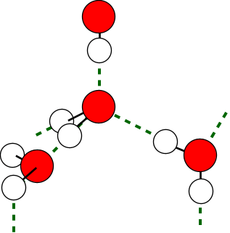
HYDROGEN BONDING - ICE
each water molecule is hydrogen-bonded to 4
others in a tetrahedral formation
ice has a “diamond-like” structure
volume is larger than the liquid making it
when ice melts, the structure collapses
slightly and the molecules come closer; they
then move a little further apart as they get
more energy as they warm up
this is why…
water has a maximum density at 4°C
ice floats.
hydrogen bonding

Slide 77
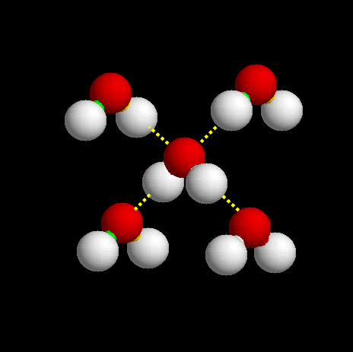
HYDROGEN BONDING - ICE
hydrogen bonding

Slide 78
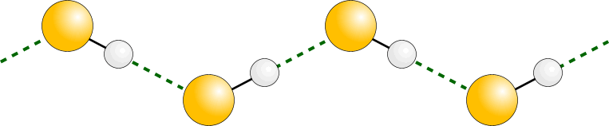
HYDROGEN BONDING - HF
δ ¯
δ ¯
F
δ ⁺
F
δ ⁺
δ ⁺
δ ⁺
H
δ ¯
H
δ ¯
H
H
F
F
hydrogen bonding
Hydrogen fluoride has a much higher boiling point than one would expect for a molecule with a relative molecular mass of 20
Fluorine has the highest electronegativity of all and is a small atom so the bonding with hydrogen is extremely polar

Slide 79
Some questions to attempt
Review exercise 4.4 p92

Slide 80
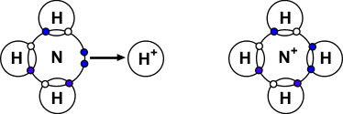
DATIVE COVALENT (CO-ORDINATE) BONDING
A dative covalent bond differs from covalent bond only in its formation
Both electrons of the shared pair are provided by one species (donor) and it shares
the electrons with the acceptor
Donor species will have lone pairs in their outer shells
Acceptor species will be short of their “octet” or maximum.
Lewis base a lone pair donor
Lewis acid a lone pair acceptor
Ammonium ion, NH₄⁺
The lone pair on N is used to share with the hydrogen ion which needs two electrons to fill its outer shell.
The N now has a +ive charge as
- it is now sharing rather than owning two electrons.

Slide 81
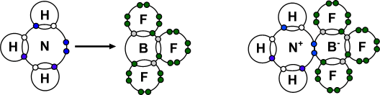
Boron trifluoride-ammonia NH₃BF₃
Boron has an incomplete shell in BF₃ and can accept a share of a pair of electrons donated by ammonia. The B becomes -ive as it is now shares a pair of electrons (i.e. it is up one electron) it didn’t have before.

Slide 82
Names and formulae of covalent molecular substances
Read chapter 4.5 p94 and attempt
Review exercise 4.5 p94

Slide 83
Compounds with both ionic and covalent bonding
Read chapter 4.6 p95 and attempt
Review exercise 4.6 p96

Slide 84
Useful covalent molecular liquids
Read chapter 4.7 p97-99 and attempt
Review exercise 4.7 p100

Slide 85
Questions to attempt
End of Chapter 4 Questions p102-105

Slide 86
MOLECULAR
SOLIDS

Slide 87
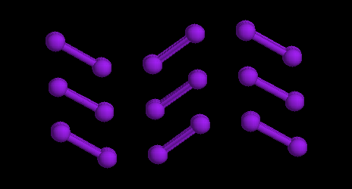
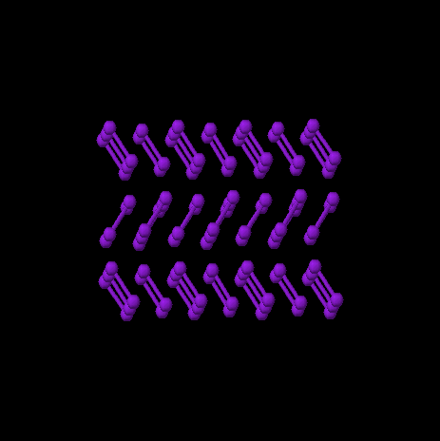
MOLECULAR SOLIDS
IODINE
At room temperature and pressure, iodine is a greyish solid. However it doesn’t need to be warmed much in order to produce a purple vapour. This is because iodine is composed of diatomic molecules (I₂) which exist in an ordered molecular crystal in the solid state. Each molecule is independent of the others, only being attracted by van der Waals’ forces. Therefore, little energy is required to separate the iodine molecules.

Slide 88
COVALENT NETWORKS
GIANT MOLECULES
MACROMOLECULES
They all mean the same!

Slide 89
GIANT (MACRO) MOLECULES
DIAMOND, GRAPHITE and SILICA
Many atoms joined together in a regular array by a large number of covalent bonds
GENERAL PROPERTIES
MELTING POINT Very high
structures are made up of a large number of covalent bonds,
all of which need to be broken if the atoms are to be separated.
ELECTRICAL Don’t conduct electricity - have no mobile ions or electrons
but... Graphite conducts electricity
STRENGTH Hard - exists in a rigid tetrahedral structure
Diamond and silica (SiO₂)... but
Graphite is soft

Slide 90
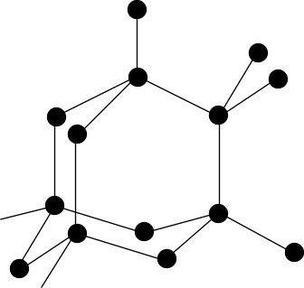
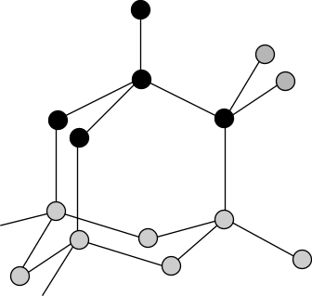
GIANT (MACRO) MOLECULES
DIAMOND
MELTING POINT VERY HIGH
many covalent bonds must be broken to separate the atoms
STRENGTH STRONG
each carbon is joined to four others in a rigid structure
Coordination Number = 4
ELECTRICAL NON-CONDUCTOR
No free electrons - all four carbon electrons are used for bonding

Slide 91
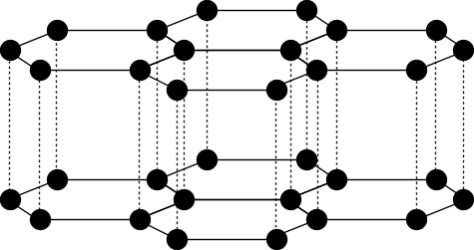
GIANT (MACRO) MOLECULES
GRAPHITE
MELTING POINT VERY HIGH
many covalent bonds must be broken to separate the atoms
STRENGTH SOFT
each carbon is joined to three others in a layered structure
Coordination Number = 3
layers are held by weak van der Waals’ forces
can slide over each other
ELECTRICAL CONDUCTOR
Only three carbon electrons are used for bonding which
leaves the fourth to move freely along layers
layers can slide over each other
used as a lubricant and in pencils

Slide 92
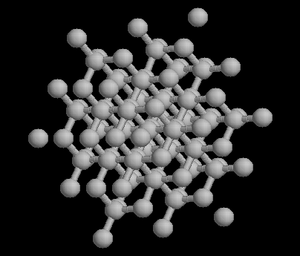
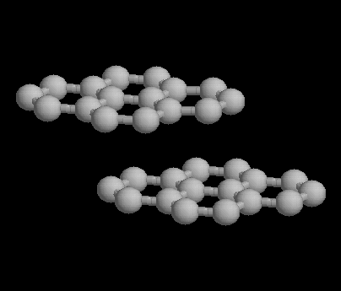
GIANT (MACRO) MOLECULES
DIAMOND
GRAPHITE

Slide 93
GIANT (MACRO) MOLECULES
SILICA
MELTING POINT VERY HIGH
many covalent bonds must be broken to separate the atoms
STRENGTH STRONG
each silicon atom is joined to four oxygen atoms - C No. = 4
each oxygen atom are joined to two silicon atoms - C No = 2
ELECTRICAL NON-CONDUCTOR - no mobile electrons

Slide 94
Reading and questions
Read Chapter 5 p106-117
Attempt Review exercises 5.1, 5.2, 5.3, 5.4.
Attempt Questions 1-4 p123

Slide 95
METALLIC
BONDING

Slide 96
METALLIC BONDING
Involves a lattice of positive ions surrounded by delocalised electrons
Metal atoms achieve stability by “off-loading” electrons to attain the electronic structure of the nearest noble gas. These electrons join up to form a mobile cloud which prevents the newly-formed positive ions from flying apart due to repulsion between similar charges.

Slide 97
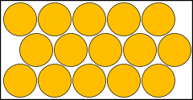
METALLIC BONDING
Involves a lattice of positive ions surrounded by delocalised electrons
Metal atoms achieve stability by “off-loading” electrons to attain the electronic structure of the nearest noble gas. These electrons join up to form a mobile cloud which prevents the newly-formed positive ions from flying apart due to repulsion between similar charges.
Atoms arrange in regular close packed 3-dimensional crystal lattices.

Slide 98
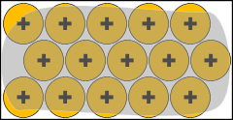
METALLIC BONDING
Involves a lattice of positive ions surrounded by delocalised electrons
Metal atoms achieve stability by “off-loading” electrons to attain the electronic structure of the nearest noble gas. These electrons join up to form a mobile cloud which prevents the newly-formed positive ions from flying apart due to repulsion between similar charges.
Atoms arrange in regular close packed 3-dimensional crystal lattices.
The outer shell electrons of each atom leave to join a mobile “cloud” or “sea” of electrons which can roam throughout the metal. The electron cloud binds the newly-formed positive ions together.

Slide 99
METALLIC BOND STRENGTH
Depends on the number of outer electrons donated
to the cloud and the size of the metal atom/ion.
The strength of the metallic bonding in sodium is relatively weak because each atom donates just one electron to the cloud.
Na

Slide 100
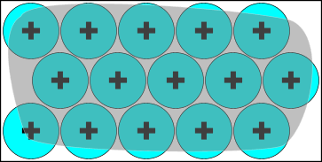
METALLIC BOND STRENGTH
Depends on the number of outer electrons donated
to the cloud and the size of the metal atom/ion.
The strength of the metallic bonding in sodium is relatively weak because each atom donates just one electron to the cloud.
The metallic bonding in potassium is weaker than in sodium because the resulting ion is larger and the electron cloud has a bigger volume to cover so is less effective at holding the ions together.
Na
K

Slide 101
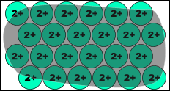
METALLIC BOND STRENGTH
Depends on the number of outer electrons donated
to the cloud and the size of the metal atom/ion.
The strength of the metallic bonding in sodium is relatively weak because each atom donates just one electron to the cloud.
The metallic bonding in potassium is weaker than in sodium because the resulting ion is larger and the electron cloud has a bigger volume to cover so is less effective at holding the ions together.
The metallic bonding in magnesium is stronger than in sodium because each atom has donated two electrons to the cloud. The greater the electron density holds the ions together more strongly.
Na
K
Mg

Slide 102
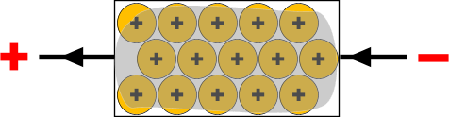
METALLIC PROPERTIES
Metals are excellent conductors of electricity
For a substance to conduct electricity it must have mobile ions or electrons.
Because the ELECTRON CLOUD IS MOBILE, electrons are free to move throughout its structure. Electrons attracted to the positive end are replaced by those entering from the negative end.
MOBILE ELECTRON CLOUD ALLOWS THE CONDUCTION OF ELECTRICITY

Slide 103

METALLIC PROPERTIES
Metals can have their shapes changed relatively easily
MALLEABLE CAN BE HAMMERED INTO SHEETS
DUCTILE CAN BE DRAWN INTO RODS AND WIRES
As the metal is beaten into another shape the delocalised electron cloud continues to bind the “ions” together.
Some metals, such as gold, can be hammered into sheets thin enough to be translucent.

Slide 104
METALLIC PROPERTIES
HIGH MELTING POINTS
Melting point is a measure of how easy it is to separate the individual particles. In metals it is a measure of how strong the electron cloud holds the positive ions.
The ease of separation of ions depends on the...
ELECTRON DENSITY OF THE CLOUD
IONIC / ATOMIC SIZE
PERIODS Na (2,8,1) < Mg (2,8,2) < Al (2,8,3)
m.pt 98°C 650°C 659°C
b.pt 890°C 1110°C 2470°C
Na⁺
Mg²⁺
Al³⁺
MELTING POINT INCREASES ACROSS THE PERIOD
THE ELECTRON CLOUD DENSITY INCREASES DUE TO THE GREATER NUMBER OF ELECTRONS DONATED PER ATOM. AS A RESULT THE IONS ARE HELD MORE STRONGLY.

Slide 105
METALLIC PROPERTIES
HIGH MELTING POINTS
Melting point is a measure of how easy it is to separate the individual particles. In metals it is a measure of how strong the electron cloud holds the positive ions.
The ease of separation of ions depends on the...
ELECTRON DENSITY OF THE CLOUD
IONIC / ATOMIC SIZE
GROUPS Li (2,1) > Na (2,8,1) > K (2,8,8,1)
m.pt 181°C 98°C 63°C
b.pt 1313°C 890°C 774°C
Li⁺
Na⁺
K⁺
MELTING POINT DECREASES DOWN A GROUP
IONIC RADIUS INCREASES DOWN THE GROUP. AS THE IONS GET BIGGER THE ELECTRON CLOUD BECOMES LESS EFFECTIVE HOLDING THEM TOGETHER SO THEY ARE EASIER TO SEPARATE.

Slide 106
Reading and questions
Read Chapter 2 p29-44
Attempt Review exercises 2.1-2.7
Attempt Questions 1-11 p46-49

Slide 107
AN INTRODUCTION TO BONDING
THE END
© JONATHAN HOPTON & KNOCKHARDY PUBLISHING

